Slide 1





SEH Project 24
Protecting Children:
Kidsafe Victoria
Road Safety

Slide 2
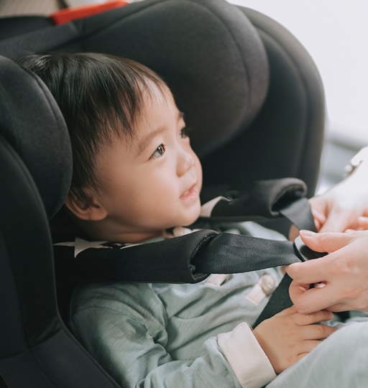

SEH Project 24
Safe Seats Safe Kids Program
"Keeping children safe while in the car"
Free child car restraint program
The Safe Seats Safe Kids Program is dedicated to ensuring the safety of children while traveling in vehicles. In order to achieve this, data analysis plays a crucial role in identifying trends, patterns, and areas of improvement. By analyzing the data collected, we can make informed decisions and implement effective strategies to further enhance the safety of children on the roads.

Slide 3

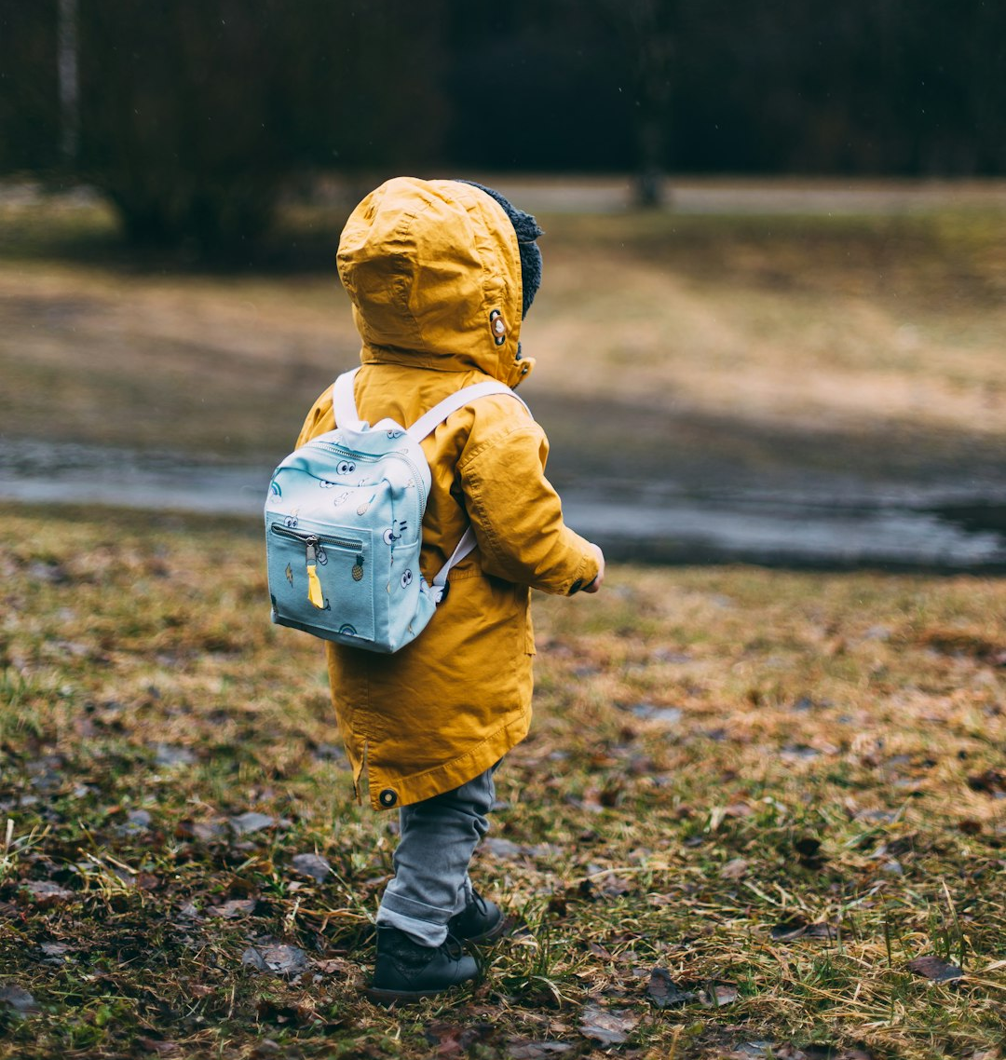

SEH Project 24
Methodologies
Data Exploration
Data Collection
Data Analysis
PowerBi Visualizations

Slide 4
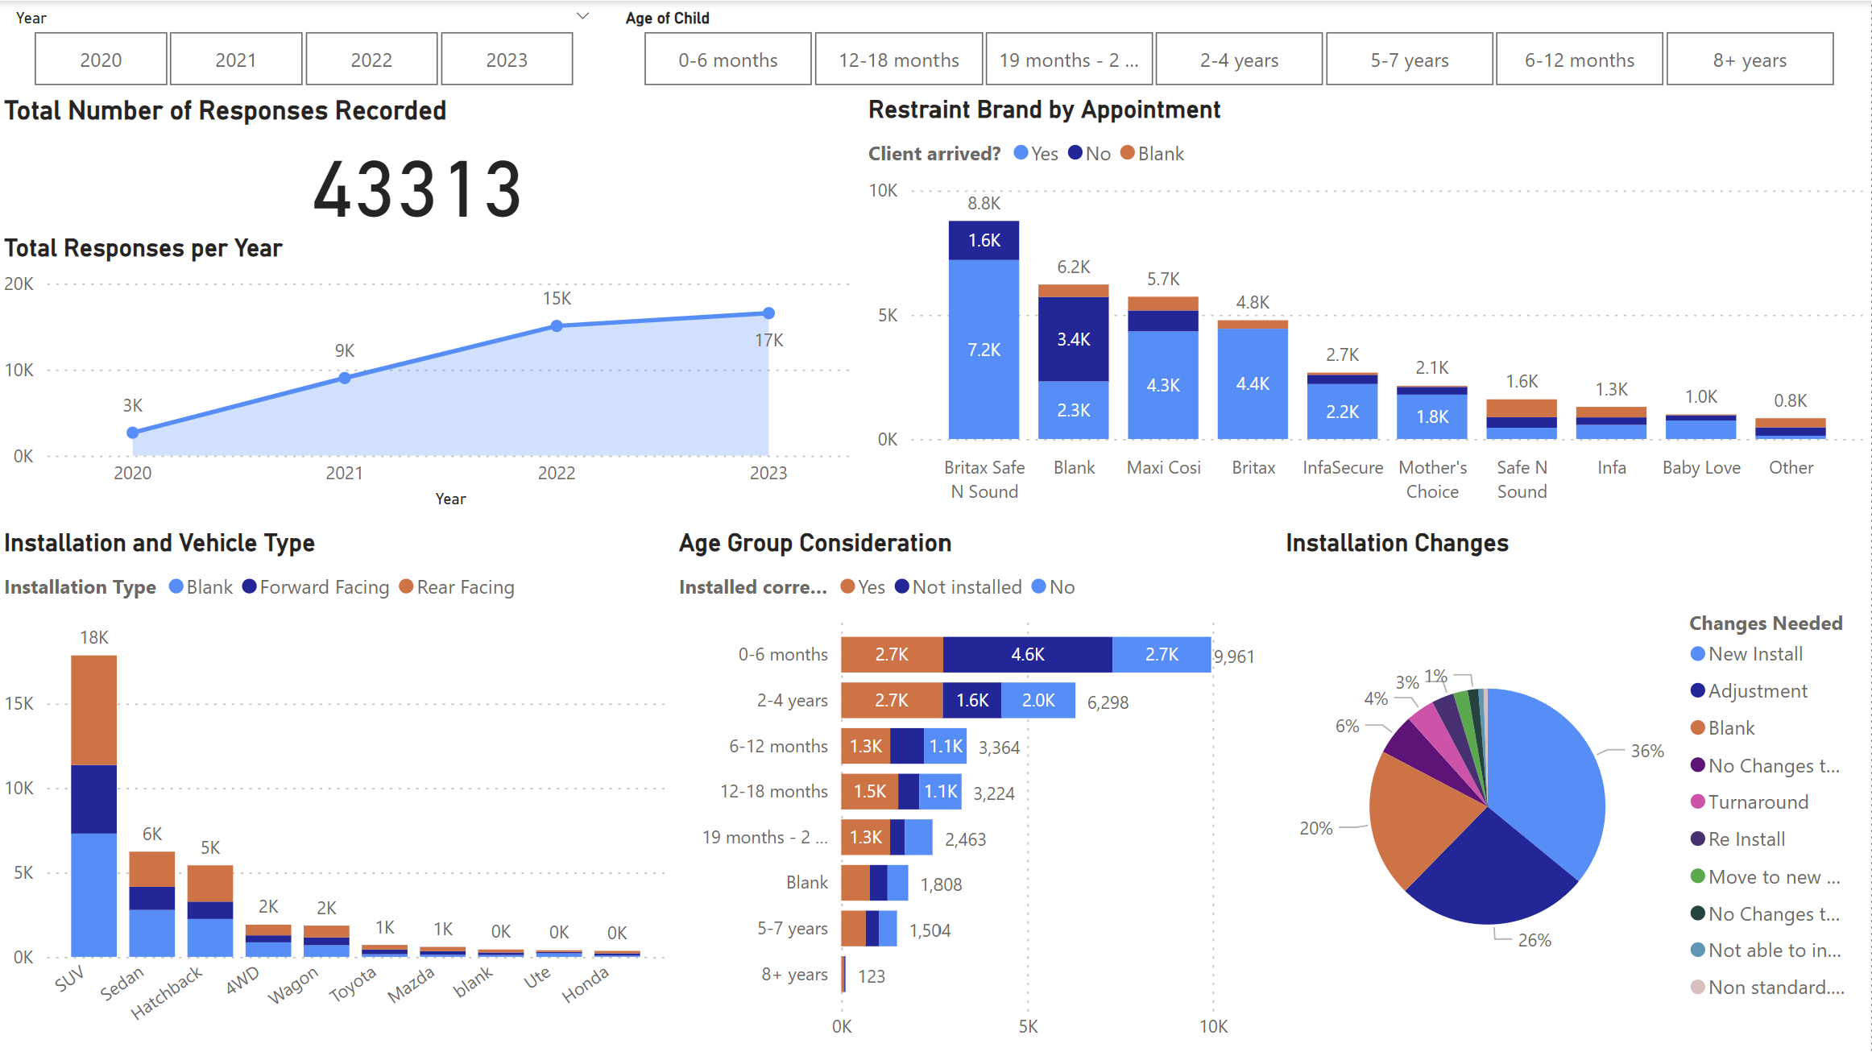
SEH Project 24
Safe Seats Safe Kids Visualizations

Slide 5
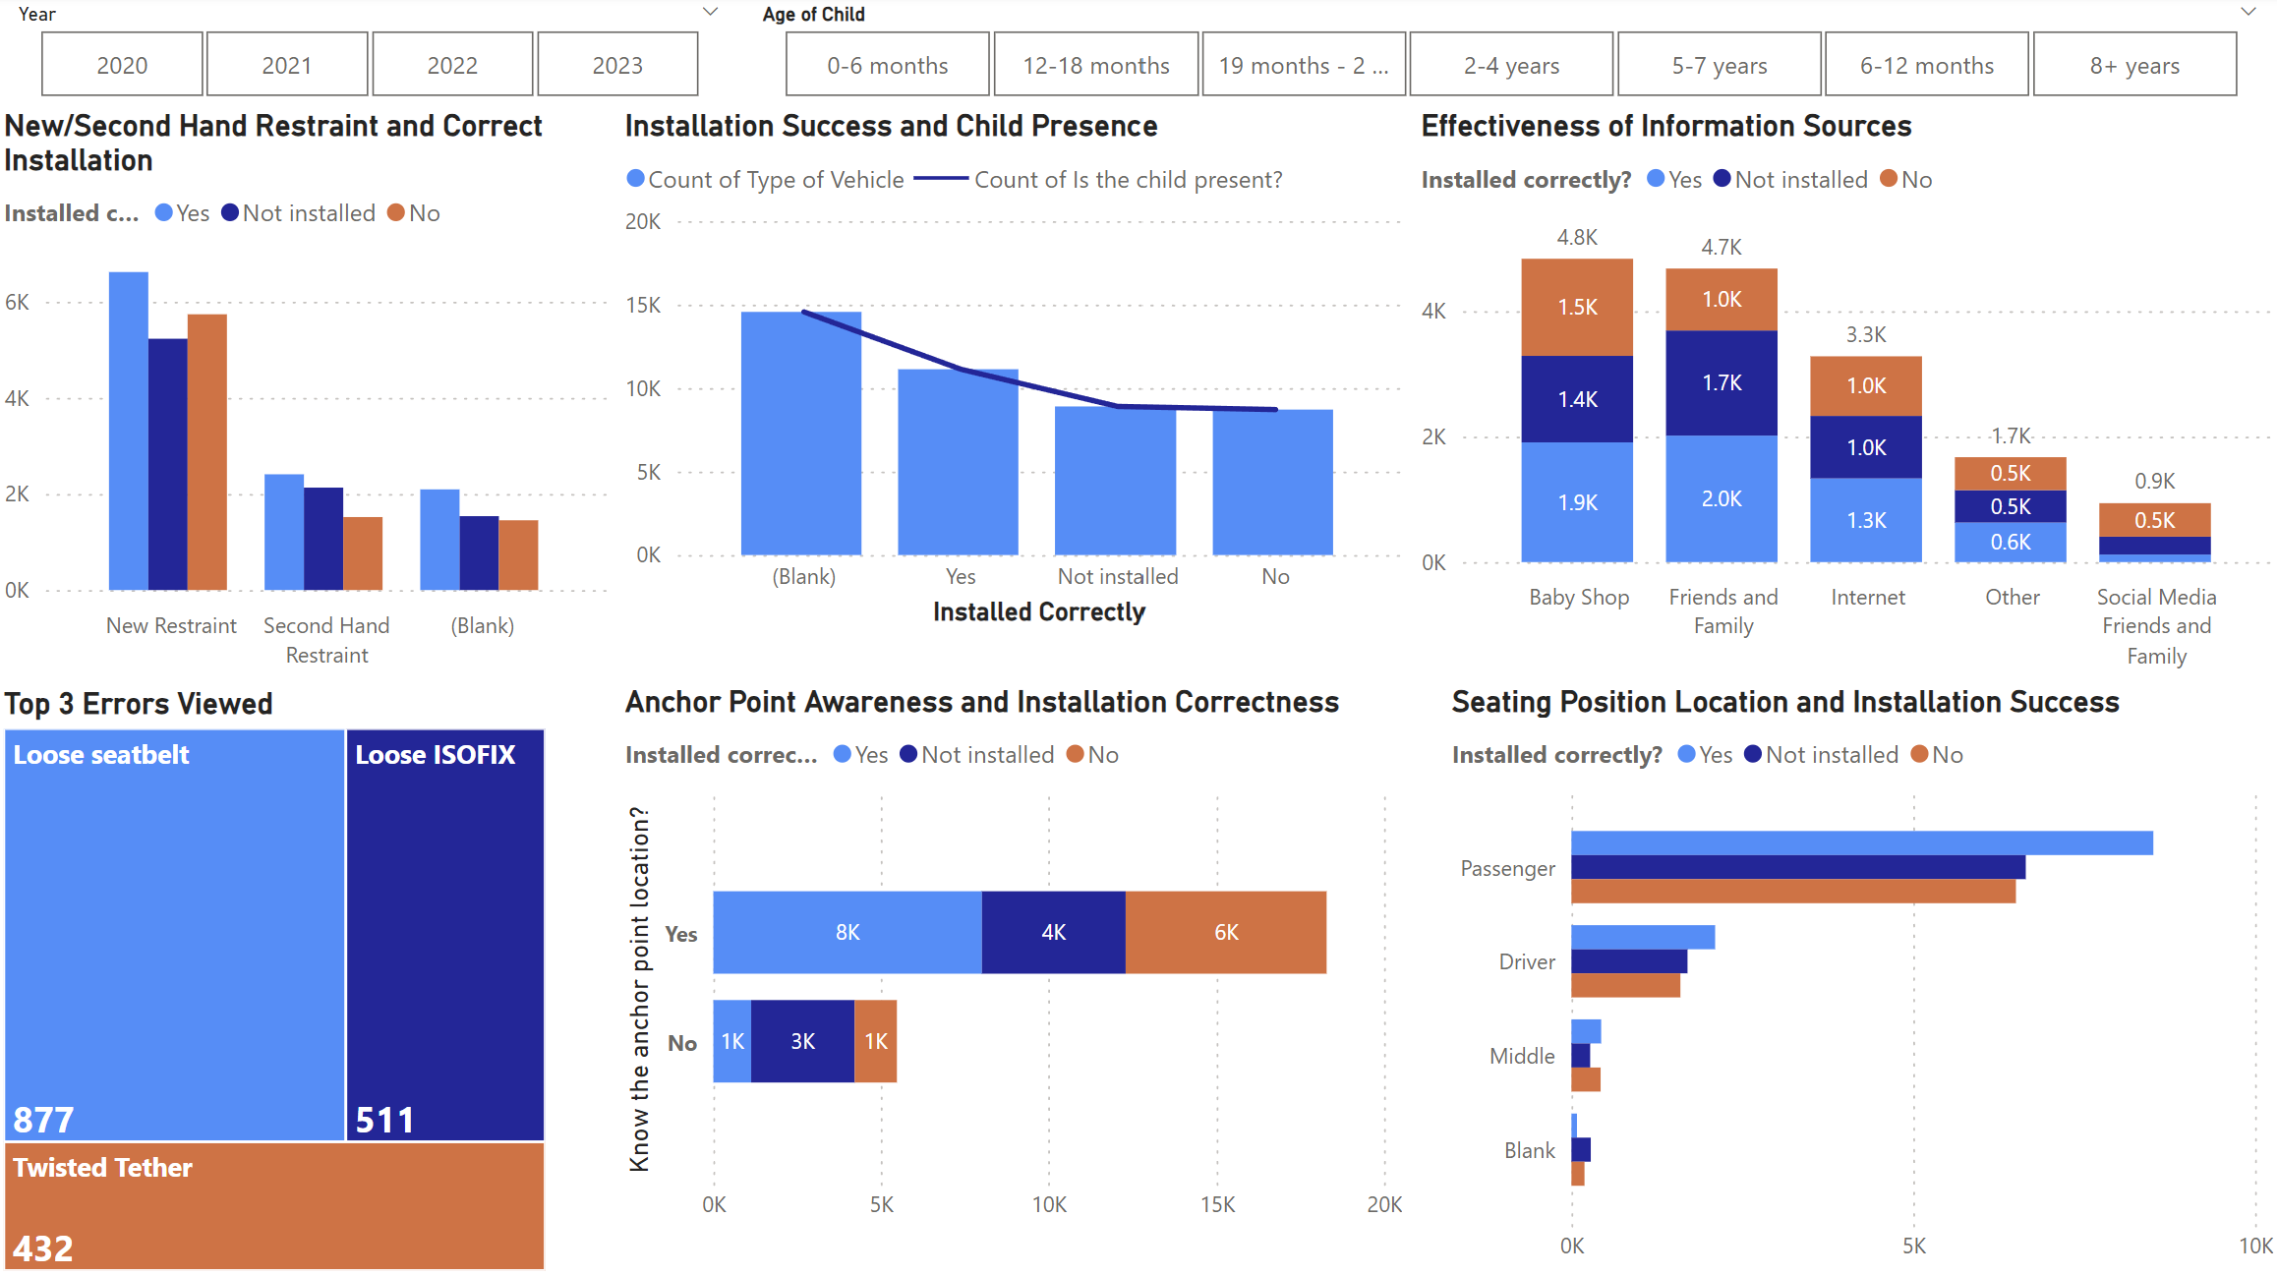
SEH Project 24
Safe Seats Safe Kids Visualizations

Slide 6
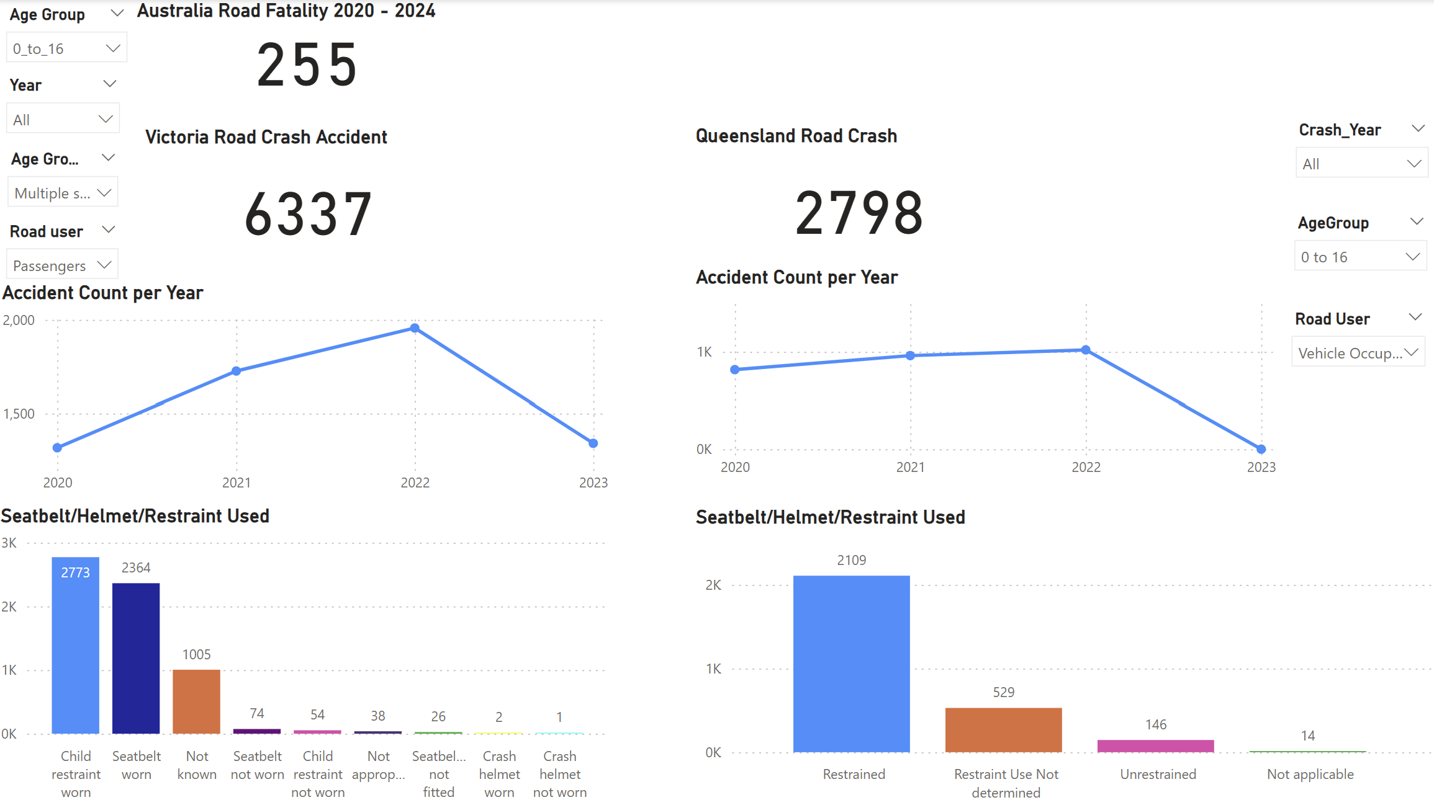
SEH Project 24
Road Crash Statistics

Slide 7

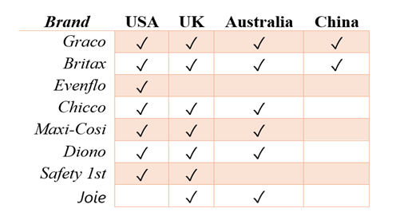
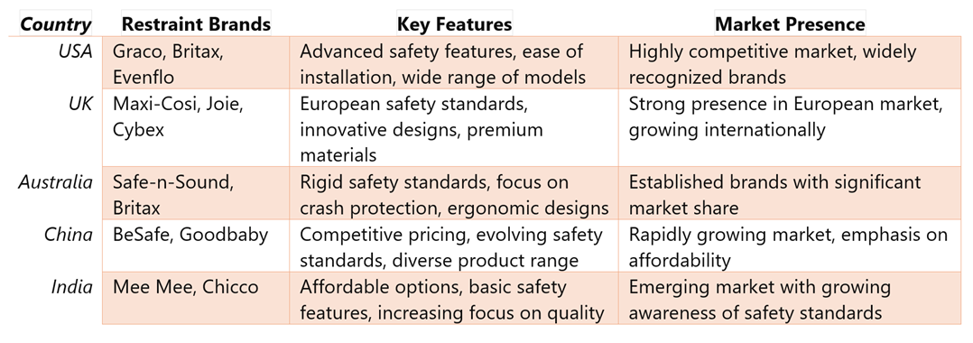
SEH Project 24
Car Restraint Brands Comparison

Slide 8
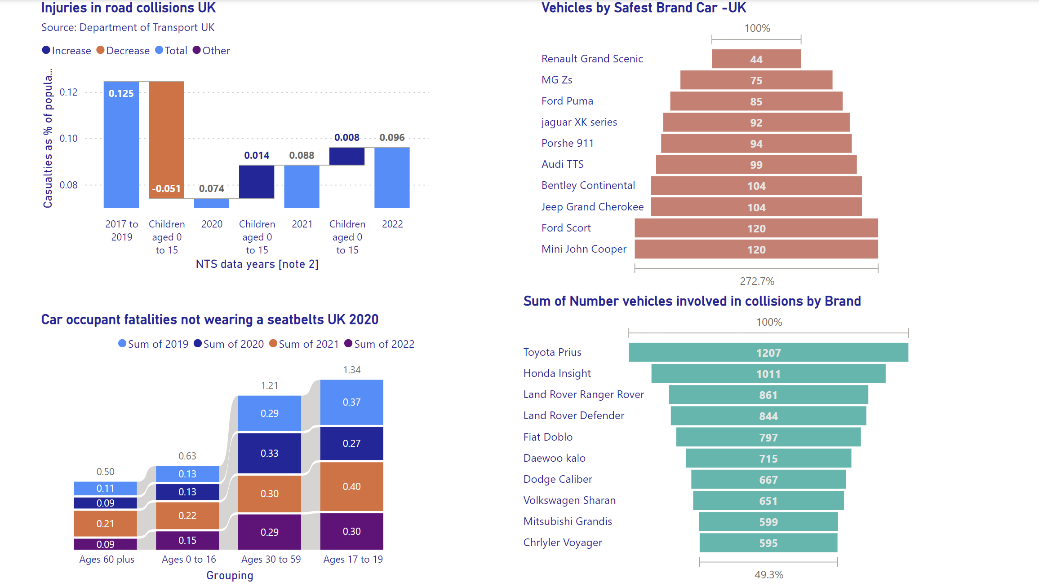
SEH Project 24
United Kingdom Comparison

Slide 9


SEH Project 24
Recommendations
1
Promote Rear-Facing Restraints for Infants and Toddlers
6
Common Errors Installation Training and Support
2
Tailored Guidance for Age Groups
7
Customized Information Dissemination
3
Vehicle-Specific Installation Guidance
8
Anchor Point Awareness
4
Partnership with Restraint Brands
9
Incentive Programs for Safety Participation
5
Education Focus on High-Impact Age Groups
10
Streamlined Data Collection and Visualization

Slide 10

SEH Project 24
References
Australian Road Deaths Database. (2024). Bureau of Infrastructure, Transport and Regional Economics. https://www.bitre.gov.au/statistics/safety/fatal_road_crash_database
Britax. (n.d.). Retrieved from https://us.britax.com/
Britax. (n.d.). Retrieved from https://www.britax.com.au/
Crash data from Queensland roads - Open Data Portal | Queensland Government. (2023). Queensland Government. https://www.data.qld.gov.au/dataset/crash-data-from-queensland-roads
Cybex. (n.d.). Retrieved from https://cybex-online.com/gb-en
Evenflo. (n.d.). Retrieved from https://www.evenflo.com/
Free Child Car Restraint Checking Program. (n.d.). Kidsafe VIC. Retrieved April 20, 2024, from https://www.kidsafevic.com.au/road-safety/free-child-car-restraint-checking-program/
Graco. (n.d.). Retrieved from https://www.gracobaby.com/
Joie. (n.d.). Retrieved from https://www.joiebaby.com/
Maxi-Cosi. (n.d.). Retrieved from https://www.maxi-cosi.co.uk/
Safe-n-Sound. (n.d.). Retrieved from https://www.britax.com.au/
Victoria Road Crash Data - Victorian Government Data Directory. (n.d.). Data Vic. https://discover.data.vic.gov.au/dataset/victoria-road-crash-data
New research reveals the cars involved in the most crashes in the UK - Driving Instructors Association. (2022) https://www.driving.org/new-research-reveals-the-cars-involved-in-the-most-crashes-in-the-uk/
Department for Transport UK – Seatbelt wearing rates. Grate Britain 2021 (2022). https://www.gov.uk/government/statistics/seatbelt-and-mobile-phone-use-surveys-2021/seatbelt-wearing-rates-great-britain-2021#other-variables.

Slide 11

SEH Project 24
Questions/Discussions
Thank you for your time!

